Slide 1

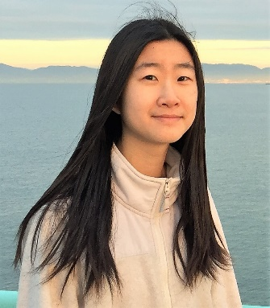


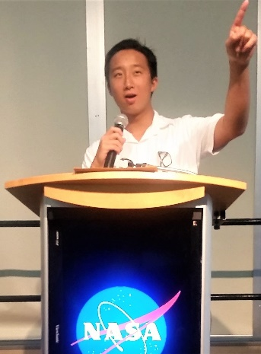

Meet THE TEAM
Team “Better Lamp” from Washington University in St. Louis
Lily Xu – Team Leader, Design
lilyxu@wustl.edu
Biomedical Engineering, 2020
Matt Shepherd – Production Manager
mshepherd@wustl.edu
Electrical Engineering, 2019
Computer Engineering, 2019
David Lie-Tjauw – Front End Lead
david.lie-tjauw@wustl.edu
Computer Science, 2020
Noah Luddy – Back End Lead
noahluddy@wustl.edu
Computer Science, 2020
Notes:
rate-my-wait.herokuapp.com

Slide 2
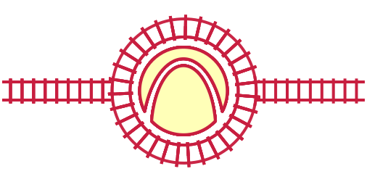


Rate my wait SUMMARY
Rate My Wait
rate-my-wait.herokuapp.com
Rate My Wait is a web app that...
Geolocates the user
Records wait time at a Metrolink train or bus station
Calculates distance from the nearest Metrolink station
Can send data files to server for analysis (not implemented)
Is accessible by computer and phone
Notes:
rate-my-wait.herokuapp.com

Slide 3
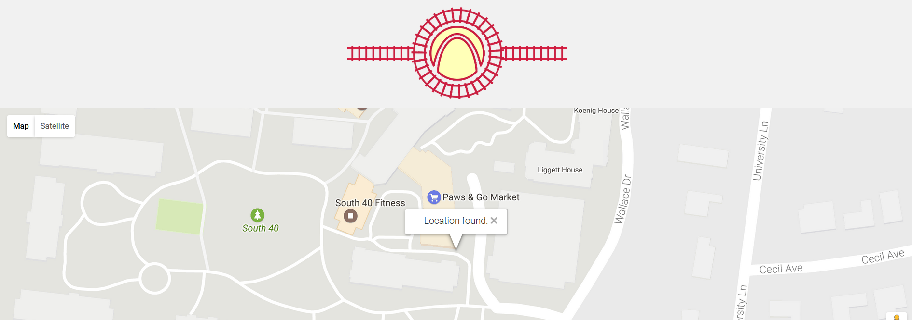
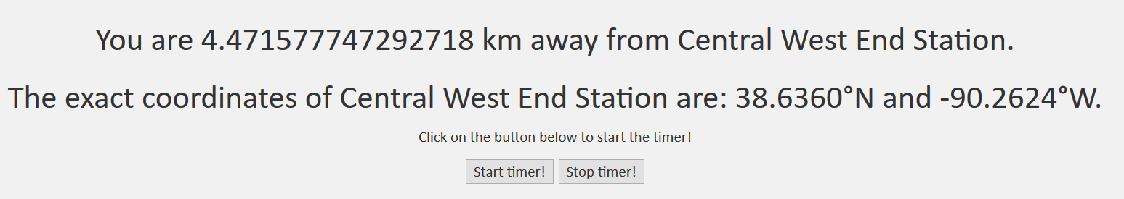
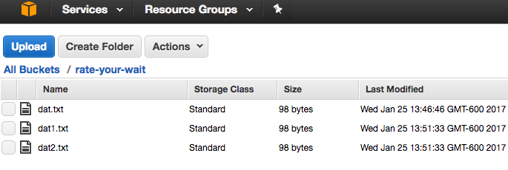
Tech Stack
Geolocate
Record
Upload
Languages: JavaScript,
PHP, HTML/CSS
Framework: JavaScript, PHP
(Web Framework)
Front End: HTML/CSS
Back End: PHP (Heroku)
Notes:
rate-my-wait.herokuapp.com

Slide 4
user Incentives
Download Incentives:
Easy access via phone or computer, no download required
Optional: Pair app use with ticket discount
Use Incentives:
Minimalistic design makes app easy to use
Google Maps is a familiar layout to most users
Using the app lets data analysts improve public transport experience
Notes:
rate-my-wait.herokuapp.com

Slide 5
Team-chosen attribute
We believe that distance between user and chosen stop is important. Here’s why:
Tells data scientists how far Metrolink users are from public transport
Provides information to accurately determine which direction users come from
Suggests where to focus public transportation development resources
All while preserving user privacy
Notes:
rate-my-wait.herokuapp.com

Slide 6
Q&A
Rate My Wait
rate-my-wait.herokuapp.com
Notes:
rate-my-wait.herokuapp.com

